Slide 1
Deep learning with Tensorflow

Slide 2
Types
Fully Connected Networks
Convolutional Neural Networks
Recurrent Neural Networks

Slide 3
Implement an image restoration model using Tensor-Flow
You will first develop a model that can restore corrupted images from the MNIST dataset
An Autoencoder( a type of FCN) would be a great candidate
Input layer with 784 nodes
A hidden layer with 64 nodes, having ReLU activation
A hidden layer with 32 nodes, having ReLU activation
A hidden layer with 64 nodes, having ReLU activation
An output layer with 784 nodes with tanh activation

Slide 4
Loading the data
from tensorflow.keras.datasets.mnist import load_data
(x_train, y_train), (x_test, y_test) = load_data()

Slide 5
Basic Data Preprocessing
Normalize the pixel values from -1 to 1
norm_x_train = ((x_train - 128.0)/128.0).reshape([-1,784])
Here, reshape([-1, 784]) will unwrap the two-dimensional images (size 28 × 28) in the data set to a single dimensional vector (size 784). When reshaping, you do not need to provide all the dimensions of the reshaped tensor

Slide 6
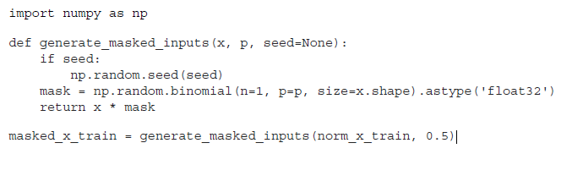
Synthesize a corresponding corrupted set of images

Slide 7
The Binomial Districution
In simple words, the binomial distribution represents the probability of heads (1) or tails (0) if you flip a coin several times. The binomial distribution has several important parameters:
N—Number of trials
P—Probability of a success (1)
Size—The number of tests (i.e., trial sets)

Slide 8
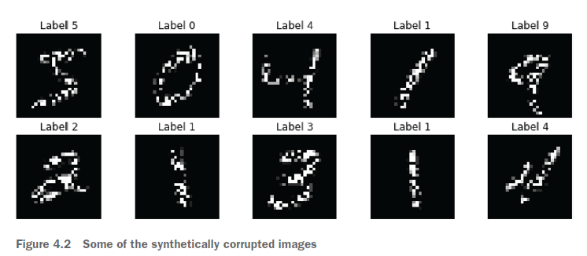
Currupted Images

Slide 9
Autoencoder
Autoencoders operate in a similar way to the multilayer perceptron.
In other words, the computations (e.g., forward pass) you see in an autoencoder are exactly the same as in an MLP.
However, the final objectives of the two are different.
An MLP is trained to solve a supervised task (e.g., classifying flower species), whereas an autoencoder is trained to solve an unsupervised task

Slide 10
Autoencoder phases
Compression phase—Compresses a given image (i.e., the corrupted image) to a
compressed hidden (i.e., latent) representation
Reconstruction phase—Reconstructs the original image from the hidden representation

Slide 11
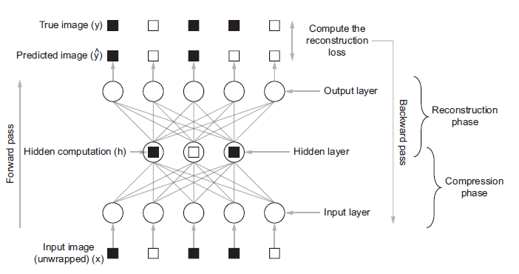

Slide 12
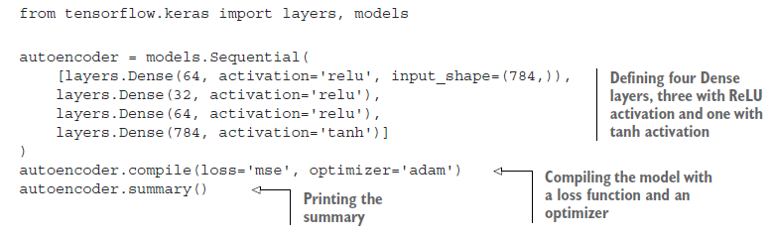
The denoising autoencoder model

Slide 13
Train the model
history = autoencoder.fit(masked_x_train, norm_x_train, batch_size=64, epochs=10)
It seems the error (i.e., loss value) has gone down from approximately 0.15 to roughly 0.078. This is a strong indication that the model is learning to reconstruct images

Slide 14
Restore an image with the trained model
x_train_sample = x_train[:10]
y_train_sample = y_train[:10]
masked_x_train_sample = generate_masked_inputs(x_train_sample, 0.5, seed=2048)
norm_masked_x = ((x_train - 128.0)/128.0).reshape(-1, 784)
y_pred = autoencoder.predict(norm_masked_x)

Slide 15
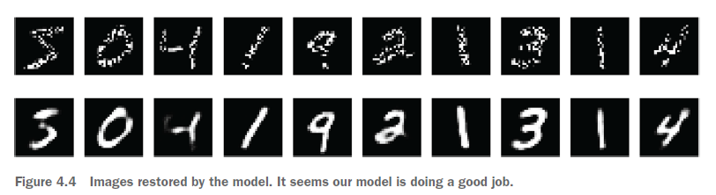
Restored images

Slide 16
What do Autoencoders help you to achieve
a great tool for learning unsupervised features from unlabeled data
When autoencoders are trained on an unsupervised task, they learn useful features for other tasks
Therefore, training an autoencoder model to classify images will get you to a well-performing model faster and with less labeled data than training a model from scratch

Slide 17
Developing a model to classify vehicles
Building a model to predict whether a vehicle is present, given a patch or image, as a part of a larger plan.
We will develop a model first on the cifar-10 data set and see how well it classifies vehicles

Slide 18
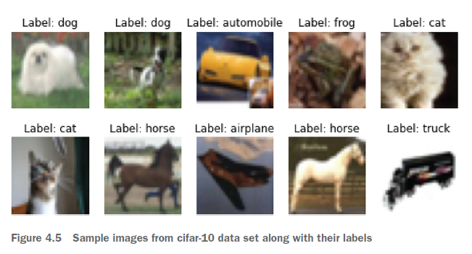
Cifar 10 data set

Slide 19
Loading the data
import tensorflow_datasets as tfds
data = tfds.load('cifar10')

Slide 20
Preprocessing
If you explore the data a bit, you will realize that
Images are provided with the data type as unsigned eight-bit integers.
Labels are provided as integer labels (i.e., not one-hot encoded).
Therefore, we will write a very simple function to convert the images to data type float32 (to make the data type consistent with the model parameters) and labels to one-hot encoded vectors:
import tensorflow as tf
def format_data(x, depth):
return (tf.cast(x["image"], 'float32'), tf.one_hot(x["label"], depth=depth))
Create a batched data
tr_data = data["train"].map(lambda x: format_data(x, depth=10)).batch(32)

Slide 21
Implementing the network
We will use CNNs
CNNs process the images while preserving their spatial information (i.e., while keeping the height and width dimensions as is), while a fully connected layer will need to unwrap the height and width dimensions to a single dimension, losing precious locality information.
Unlike a fully connected layer where every input is connected to every output, the convolution operation shifts a smaller kernel over the entire image, demanding only a handful of parameters in a layer, making CNNs very parameter efficient.

Slide 22
Types of Layers in CNN
Convolution layers
Pooling layers
Fully connected layers

Slide 23
The convolution layer
A convolution layer consists of several filters (i.e., convolution kernels) that are convolved over the image to produce a feature map. The feature map is a representation of how strongly a given filter is present in the image

Slide 24
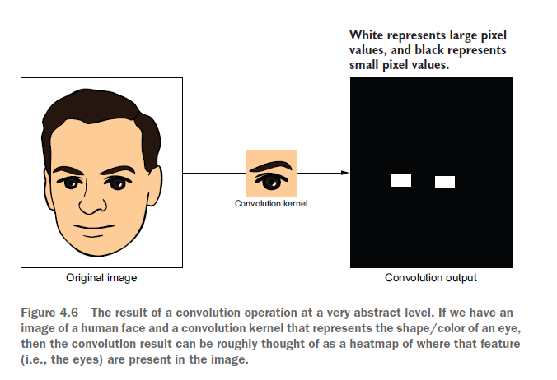

Slide 25
The convolution layer
Another important characteristic of the convolution layers is that the deeper you go in the network (i.e., further away from the input), the more high-level features the layers learn. Going back to our face recognition example, the lower layers might learn various edges present; the next layer, the shape of an eye, ear, and a nose; the next layer, how two eyes are positioned, the alignment of the nose and mouth; and so on

Slide 26
The pooling layer
Next, the pooling layer takes in feature maps generated by a convolution layer and reduces their height and width dimensions.
It helps the model be translation invariant during the machine learning task
For instance, if the task is image classification, even if the objects appear several pixels offset from what was seen during training, the network is still able to identify the object

Slide 27
The fully connected layers
Finally, to get the final probability distribution, you have several fully connected layers. But you might have suspected an issue we face here. A convolution/pooling layer produces a three-dimensional output (i.e., height, width, and channel dimensions).
But a fully connected layer accepts a one-dimensional input.

Slide 28
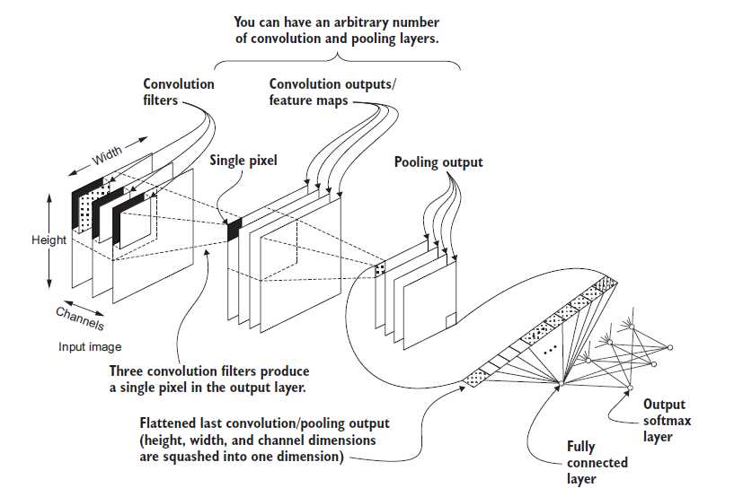

Slide 29
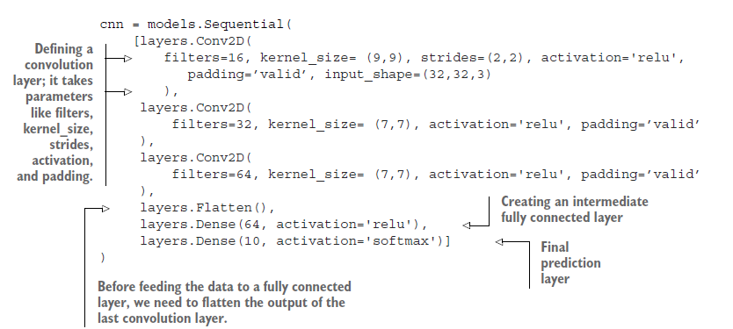

Slide 30
The Conv2D layer arguments
filters—The number of output channels that will be present in the output.
kernel_size—The convolution window size on the height and width dimensions, in that order.
strides—Represents how many pixels are skipped on height and with dimensions (in that order) every time the convolution window shifts on the input. Having a higher value here helps to reduce the size of the convolution output quickly as you go deeper.

Slide 31
The Conv2D layer
activation—The nonlinear activation of the convolution layer.
padding—Type of padding used for the border while performing the convolution operation. Padding borders gives more control over the size of the output.
input_shape—A three-dimensional tuple representing the input size on (height, width, channels) dimensions, in that order. Remember that Keras adds an unspecified batch dimension automatically when specifying the shape of the data using this argument.

Slide 32
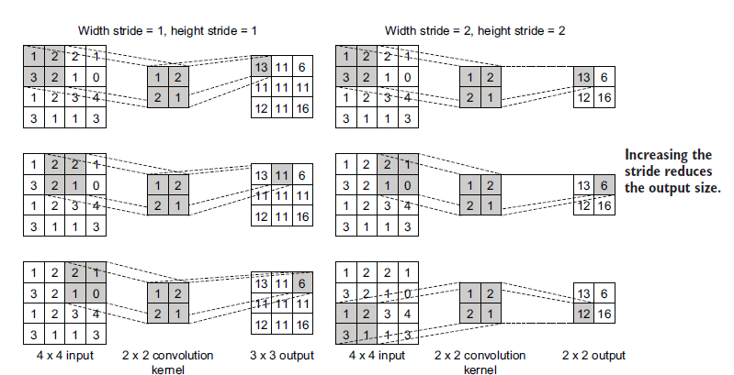

Slide 33
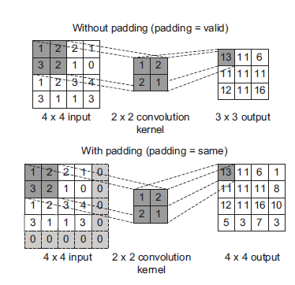

Slide 34
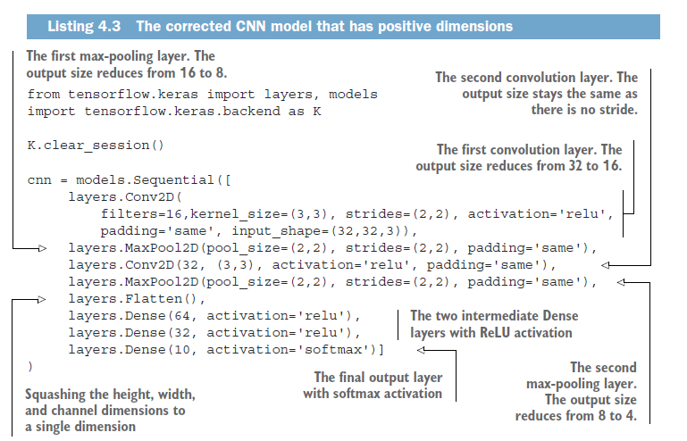

Slide 35
Performance bottlenecks of CNNs
Typically, in a CNN the very first Dense layer after the convolution/pooling layers is considered a performance bottleneck. This is because this layer will usually contain a large proportion of the parameters of the network.
Assume you have a CNN where the last pooling layer produces an 8 × 8 × 256 output followed by a Dense layer with 1,024 nodes. This Dense layer would contain 16,778,240 (more than 16 million) parameters. If you don’t pay attention to the first Dense layer of the CNN, you can easily run into out-of-memory errors while running the model.

Slide 36
Test our CNN
cnn.compile(loss='categorical_crossentropy', optimizer='adam', metrics=['acc’])
history = cnn.fit(tr_data,epochs=25)

Slide 37
Results
It seems we are getting good at training accuracies (denoted by acc) and creating a steady reduction of the training loss (denoted by loss) for the task of identifying vehicles (around 72.2% accuracy).
But we can go for far better accuracies by employing various techniques that we will cover later

Slide 38
Recurrent Neural Network
Given the data for CO2 concentration over the last three decades. You have been tasked with developing a machine learning model that predicts CO2 concentration for the next five years.
RNN can be used for this task

Slide 39
RNNs
Typical feed-forward networks (i.e., fully connected networks, CNNs) cannot learn from time series data without special adaptations. However, there is a special type of neural network that is designed to learn from time series data. These networks are generally known as RNNs. RNNs not only use the current input to make a prediction, but also use the memory of the network from past time steps, at a given time step.

Slide 40
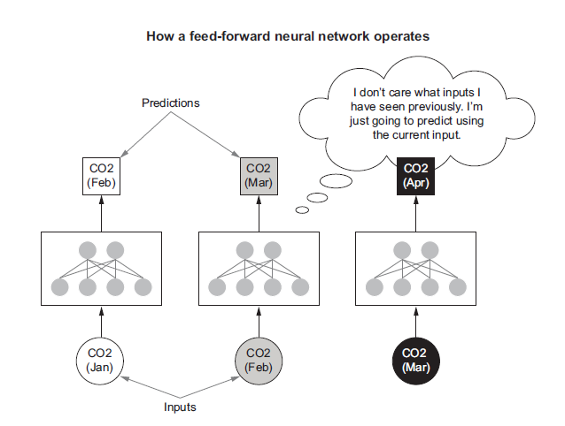

Slide 41
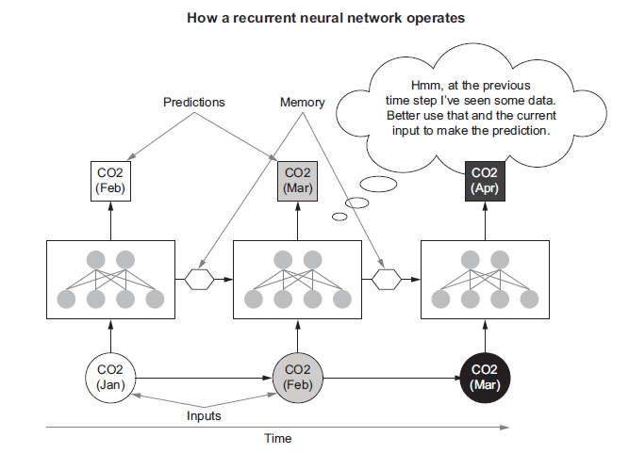

Slide 42
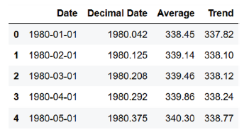
Understanding the data
https://datahub.io/core/co2-ppm/r/co2-mm-gl.csv
Each datapoint has a date (YYYY-MM-DD format) and a floating-point value representing the CO2 concentration in CSV format

Slide 43
Visualize the data

Slide 44
Insights
data has an upward trend and short repetitive cycles.
The range increases as we go further and further down the timeline.
But if you forget the absolute values and think about this data relative to the previous value, you will see that it moves between a very small range of values (appx –2.0 to +1.5)
Let’s create a new col avg diff and plot the col
data["Average Diff"]=data["Average"] - data["Average"].shift(1).fillna(method='bfill’)

Slide 46
Insights
From an ever-increasing data stream, we have gone to a stream that changes within a short vertical span. The next step is creating batches of data for the model to learn. How do we create batches of data for a time series problem?
Remember, we cannot just randomly sample data naively, as each input depends on its predecessors.
Let’s assume we want to use 12 past CO2 concentration values (i.e., 12 time steps) to predict the current CO2 concentration value

Slide 47
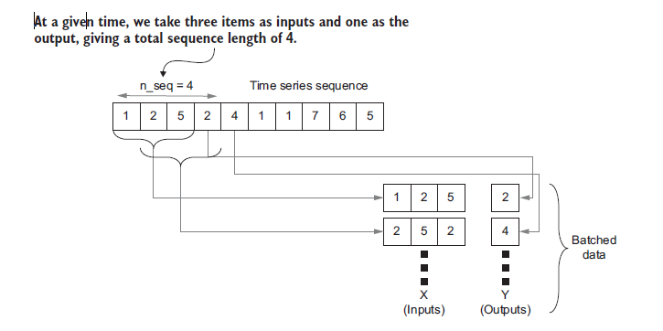

Slide 48
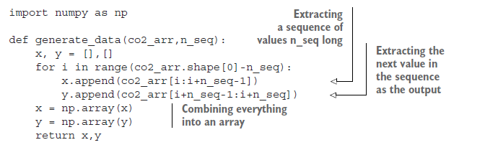

Slide 49
Implementing the model
from tensorflow.keras import layers, models
rnn = models.Sequential([
layers.SimpleRNN(64),
layers.Dense(64, activation='relu’),
layers.Dense(1)
])

Slide 50
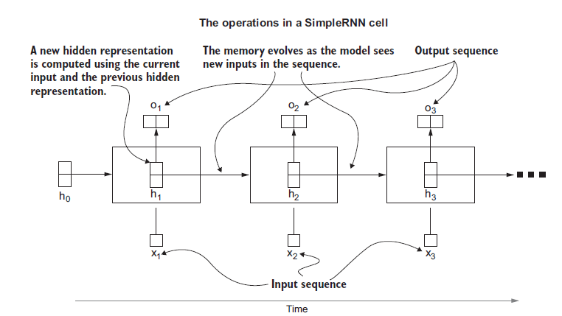

Slide 51
RNN details
An RNN goes from one input to the other in the input sequence (i.e., x1, x2, x3) in the given order.
At each step, the recurrent layer produces an output (i.e., o1, o2, o3) and passes the hidden computation (h0, h1, h2, h3) to the next time step. Here, the first hidden state (h0) is typically set to zero.

Slide 52
RNN details
By default, the SimpleRNN does not expose the hidden state to the developer and will be propagated between time steps automatically. For this task, we only need the final output produced by each time step, which is the output of that layer by default. Therefore, you can simply connect the SimpleRNN in the Sequential API to a Dense layer without any additional work.

Slide 53
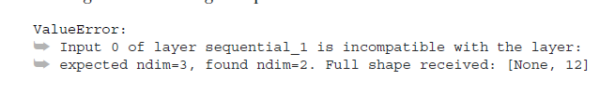
Training the model
rnn.compile(loss='mse', optimizer='adam’)
x, y = generate_data(data[“Average Diff”], n_seq=13)
rnn.fit(x, y, shuffle=True, batch_size=64, epochs=25)

Slide 54
Specification
The problem is that the SimpleRNN (or any other sequential layer in tf.keras) only accepts data in a very specific format. The data needs to be three-dimensional, with the following dimensions, in this order:
1 Batch dimension
2 Time dimension
3 Feature dimension

Slide 55
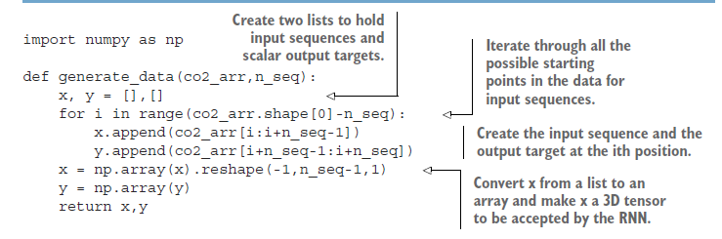
Fix

Slide 56
Training
x, y = generate_data(data[“Average Diff”], n_seq=13)
rnn.fit(x, y, shuffle=True, batch_size=64, epochs=25)
We start with a loss of approximately 0.5 and end up with a loss of roughly 0.015.
This is a very positive sign, as it indicates the model is learning the trends present in the data.

Slide 57
Predicting future CO2 values
It is much easier to evaluate models on classification tasks than regression tasks. In classification tasks (assuming a balanced data set), by computing the overall accuracy on the data, we can get a decent representative number on how well our model is doing.
In regression tasks it’s not so simple. We cannot measure an accuracy on regressed values, as the predictions are real values, not classes.
For example, the magnitude of the mean squared loss depends on values we are regressing, which makes them difficult to objectively interpret.

